Slide 1
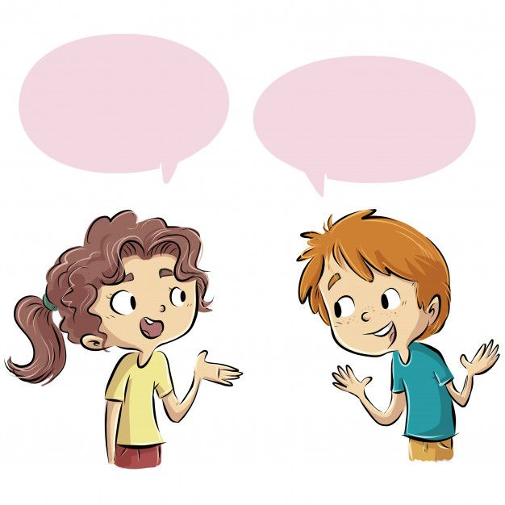
ESL CLASS

Slide 2

My favorite…

Slide 3
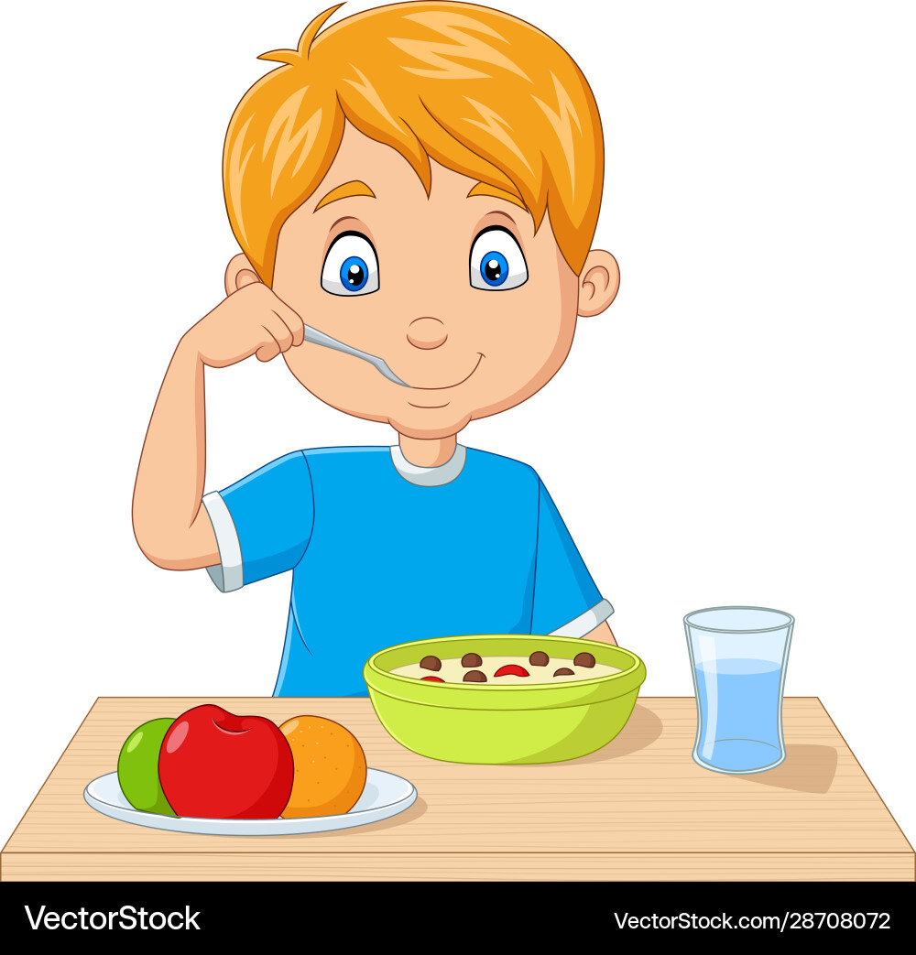
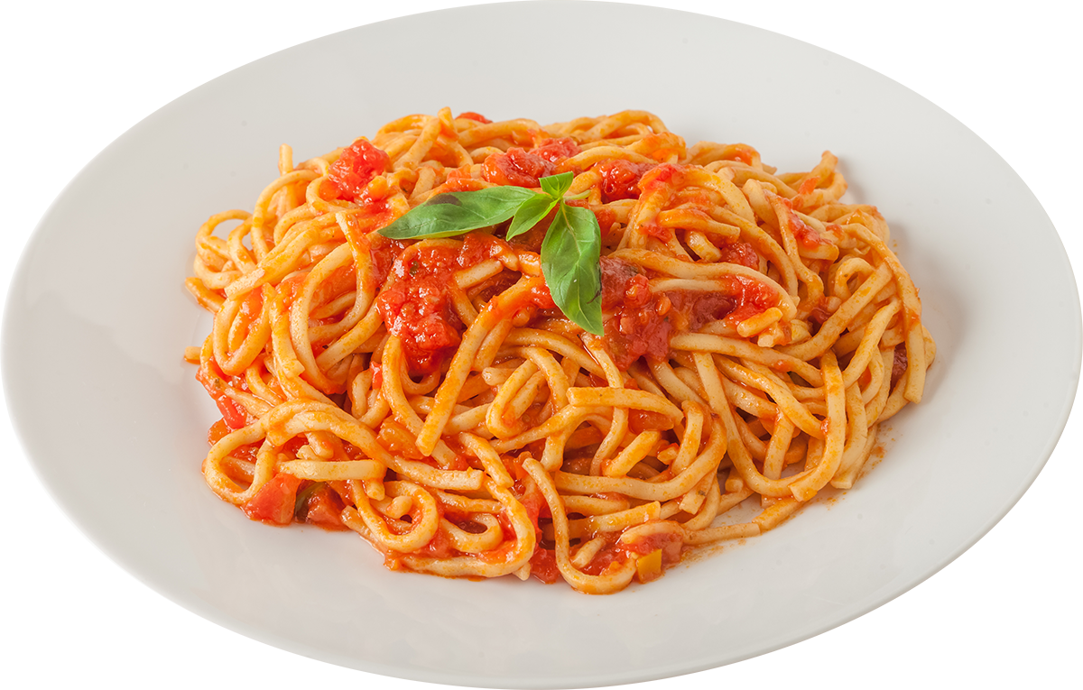
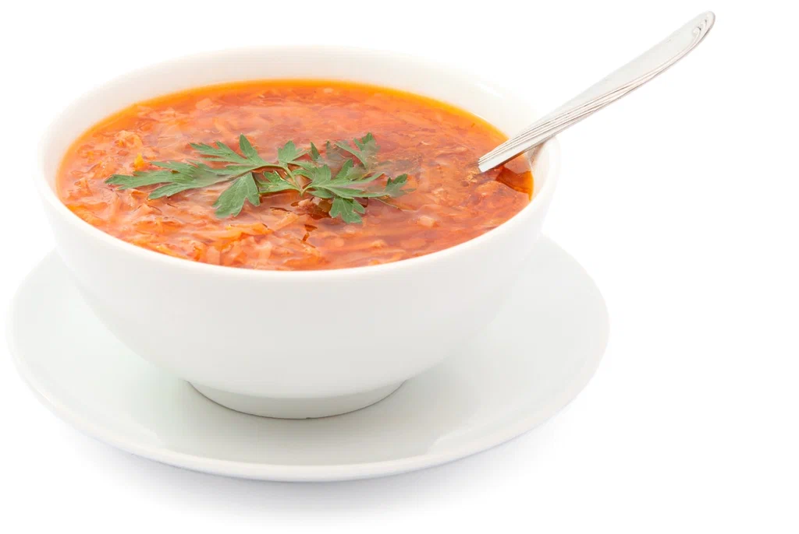
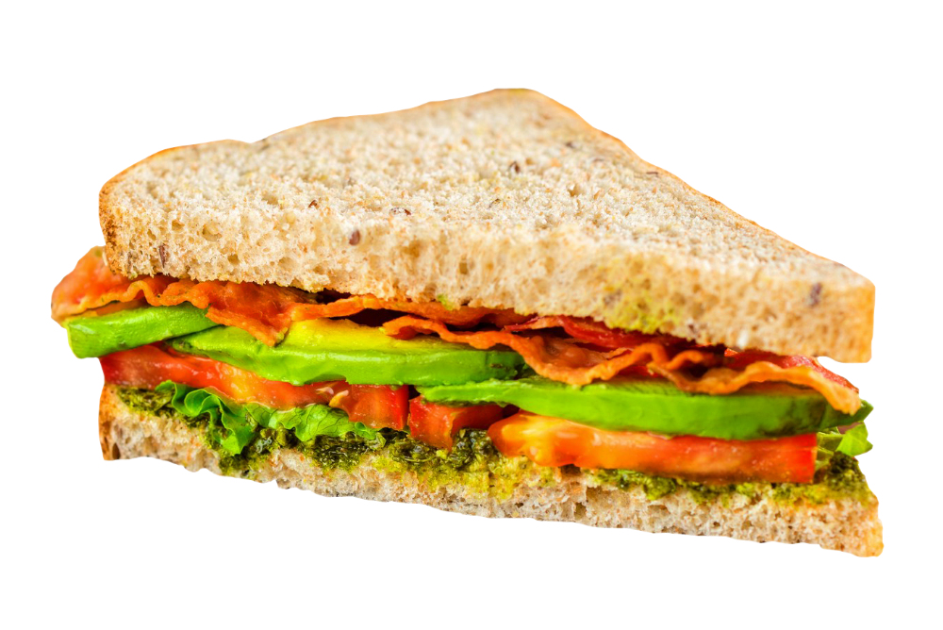
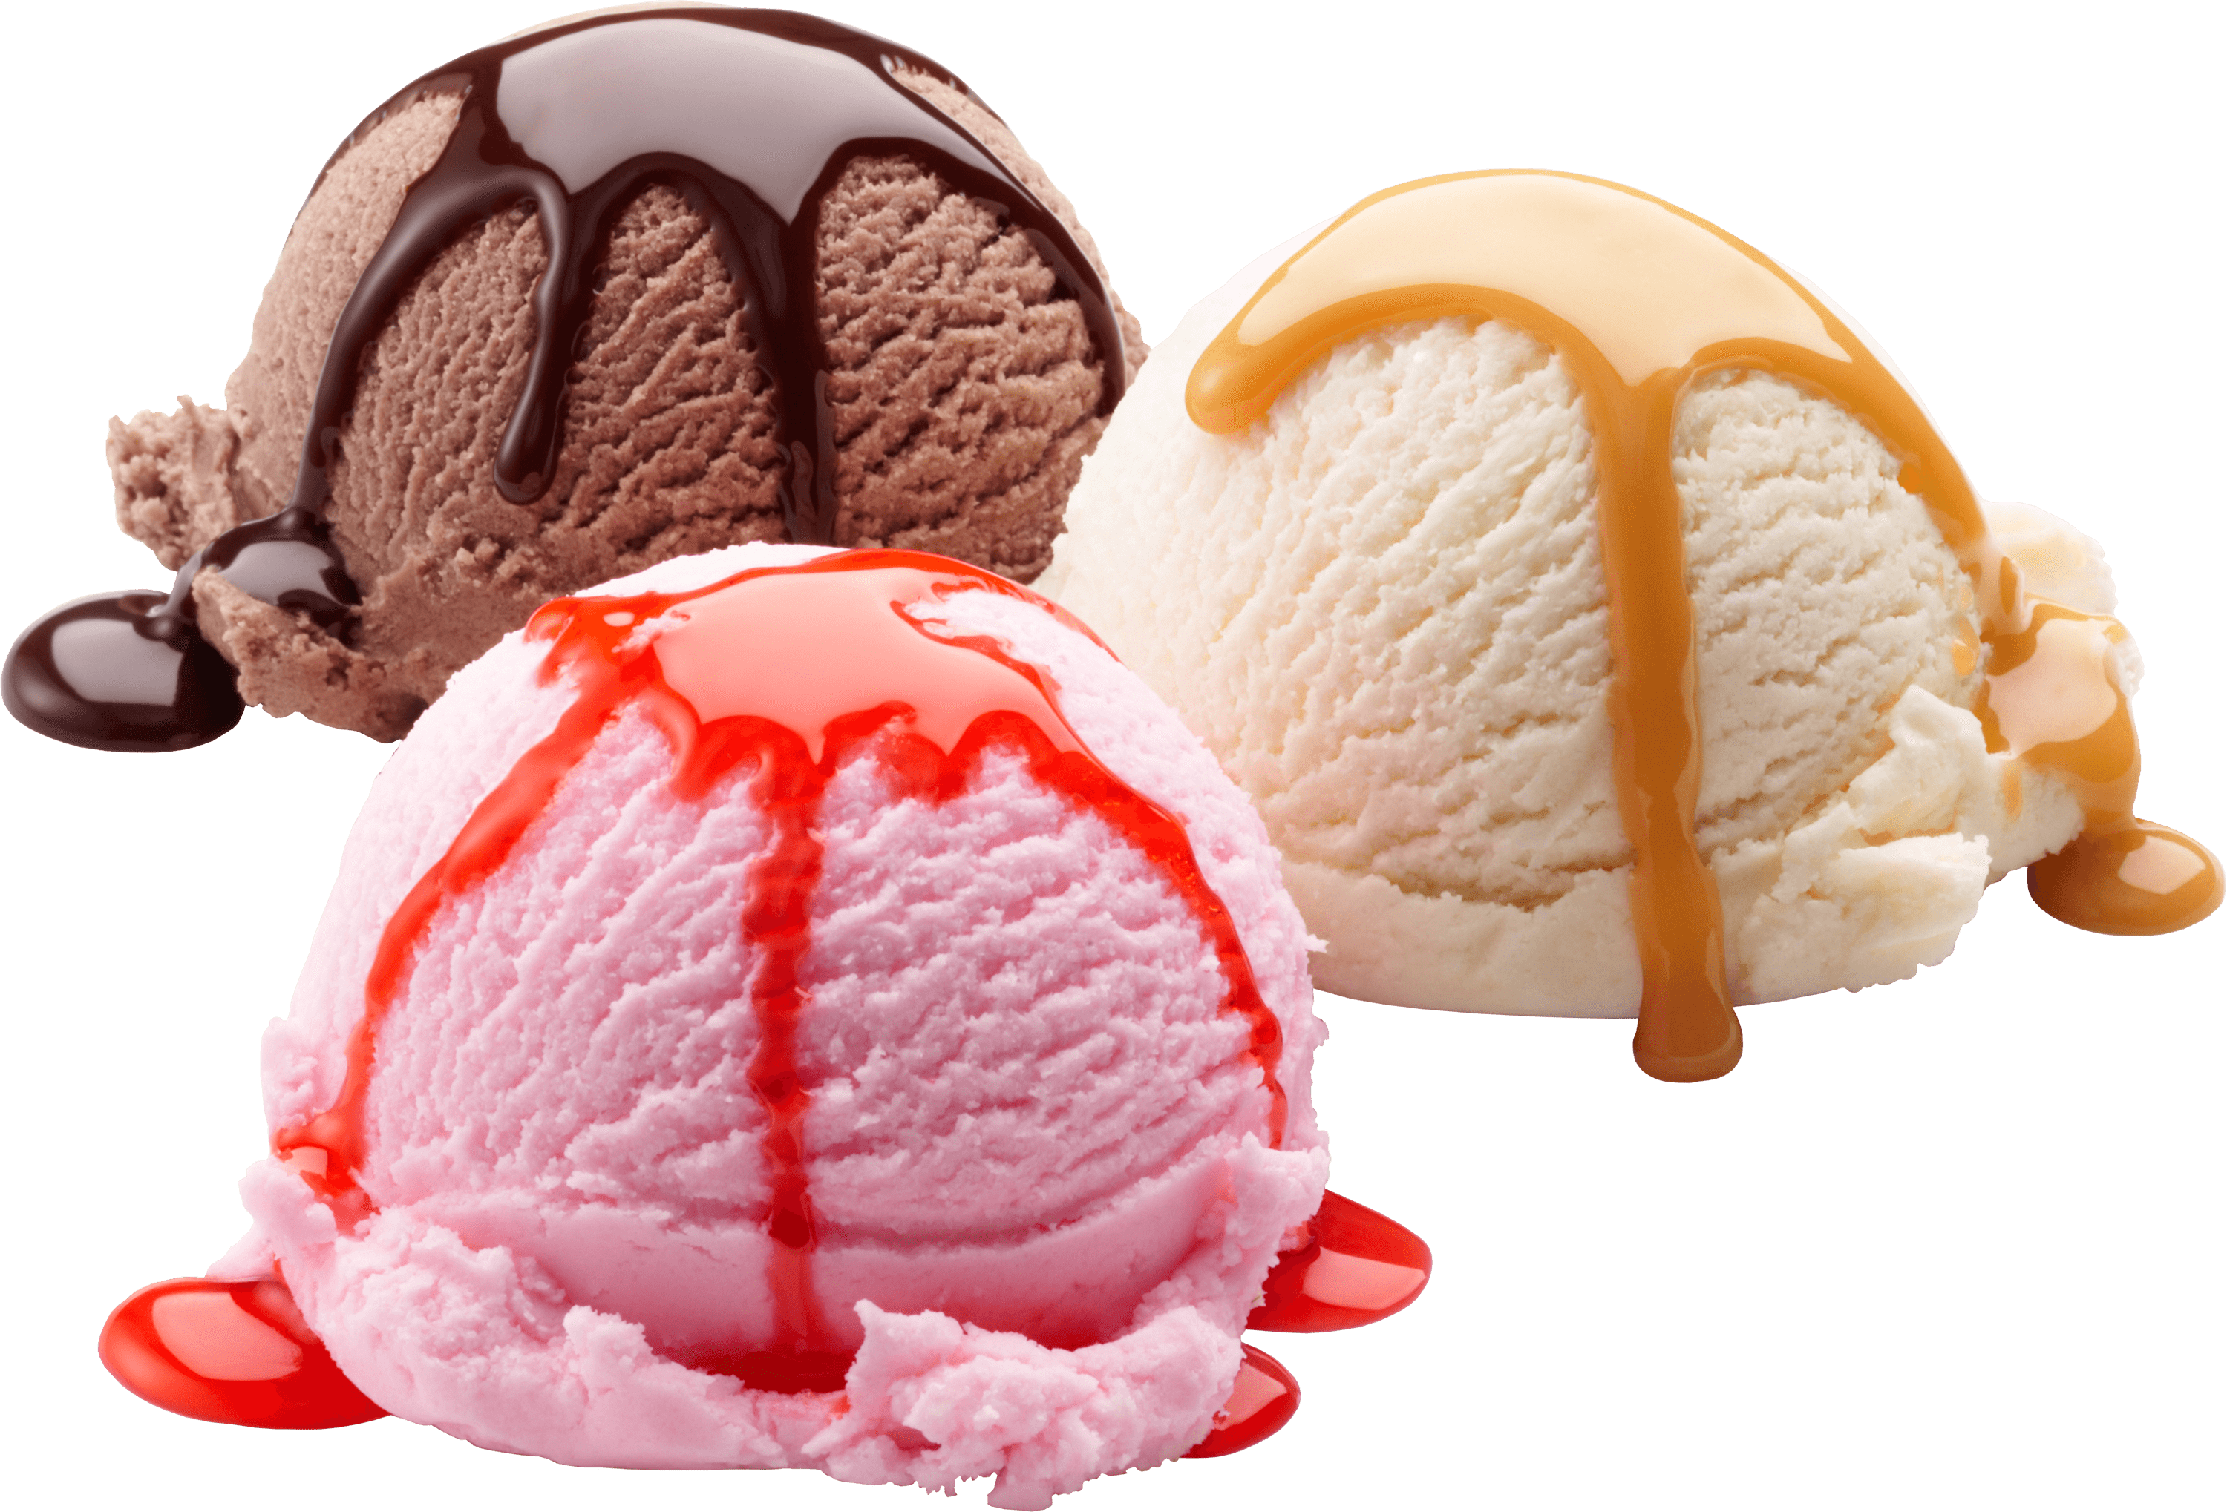
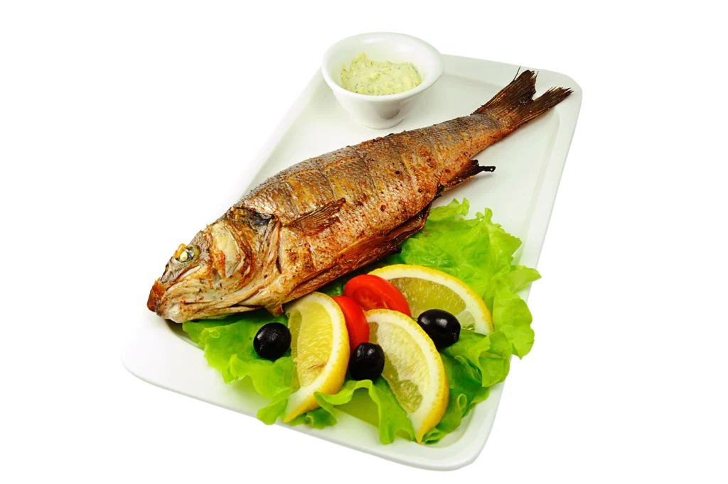
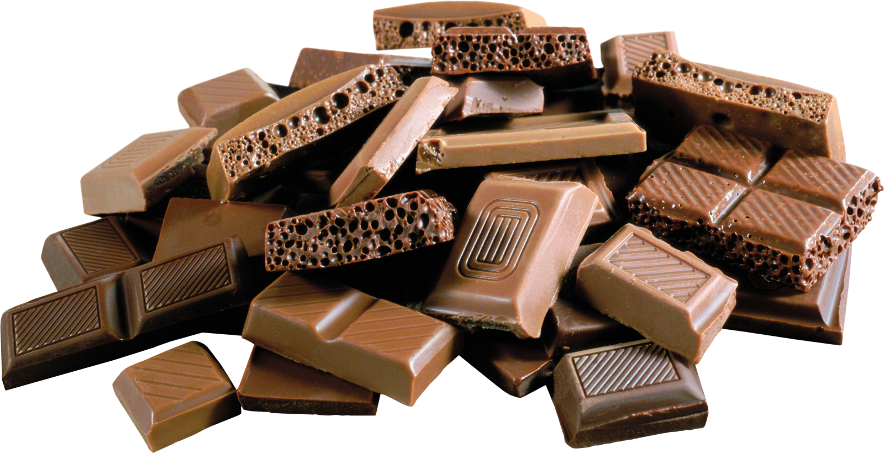
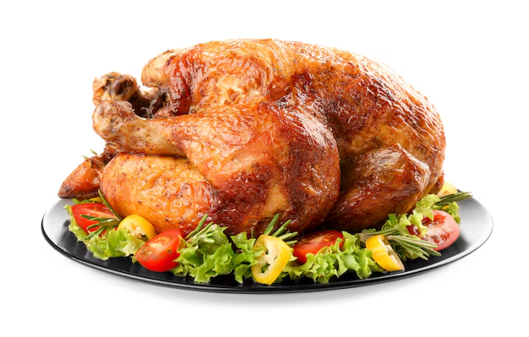
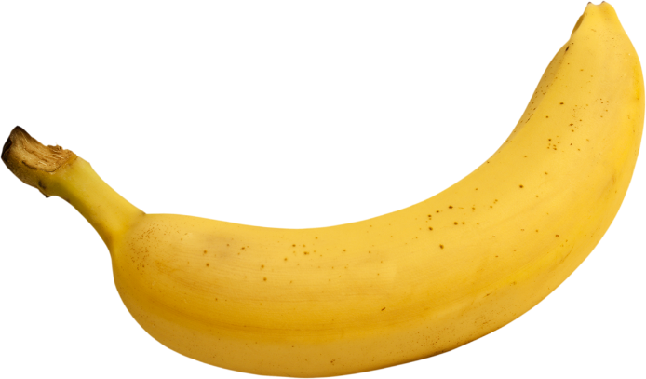

What is your favorite food?
My favorite food is…

Slide 4
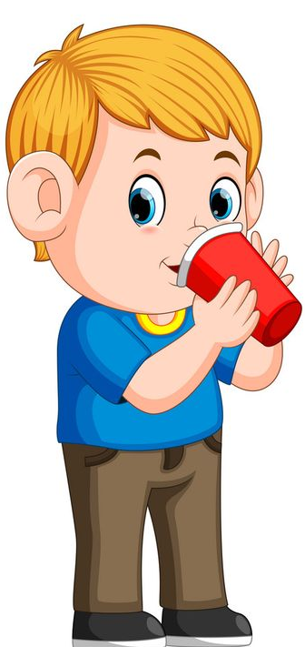
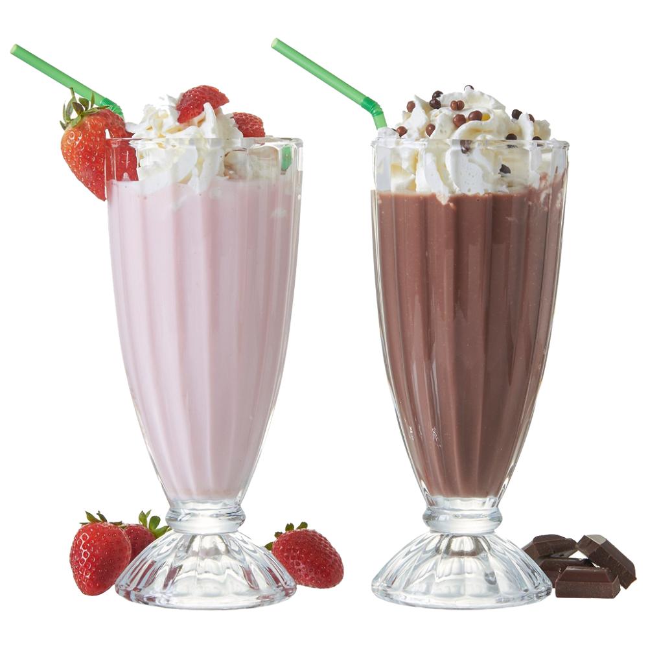
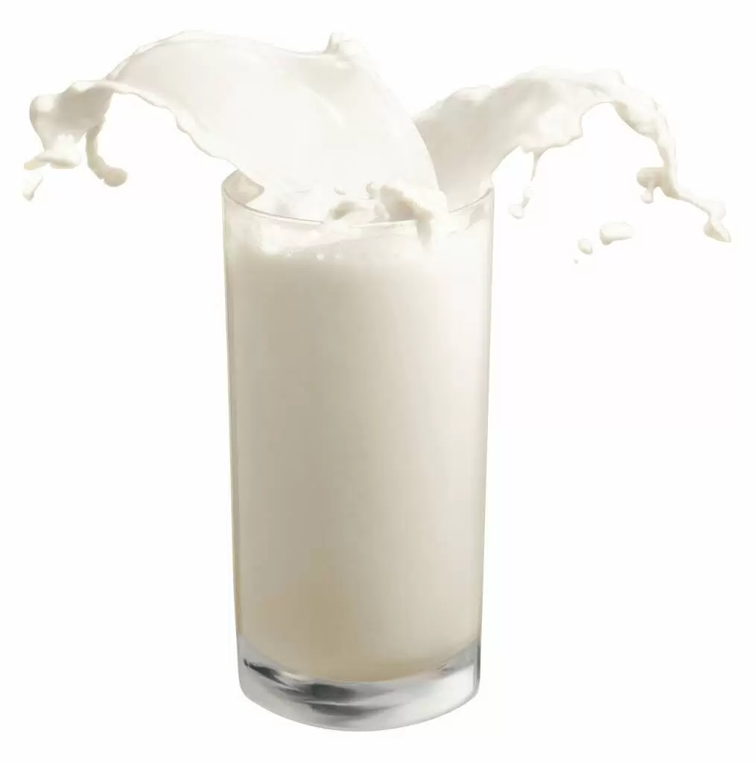
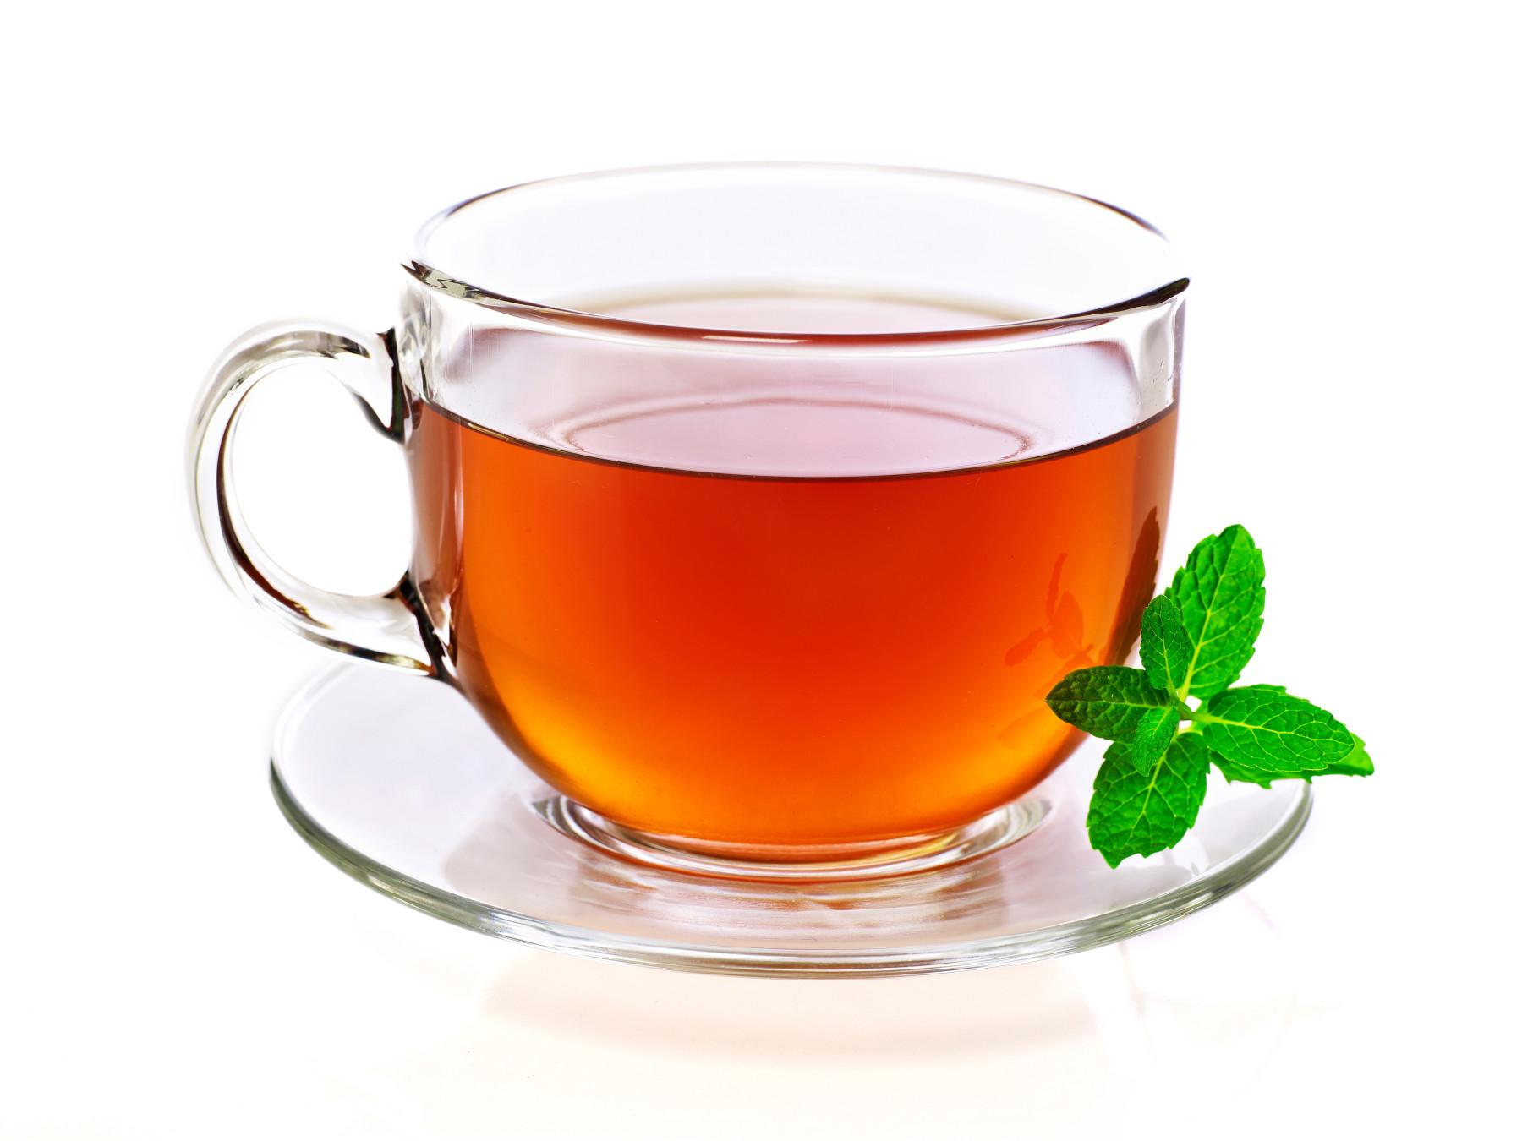
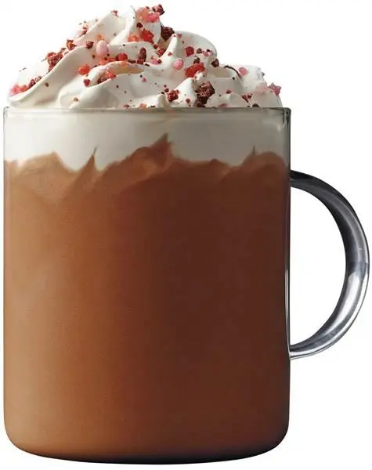
What is your favorite drink?
My favorite …

Slide 5
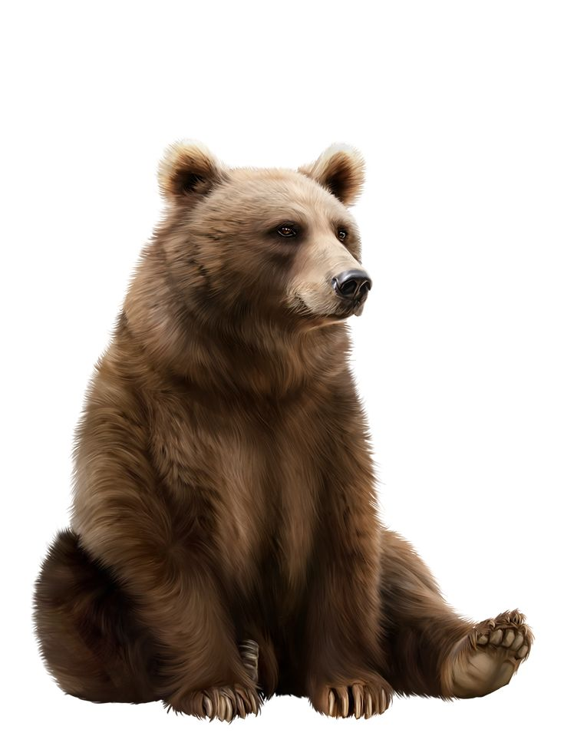
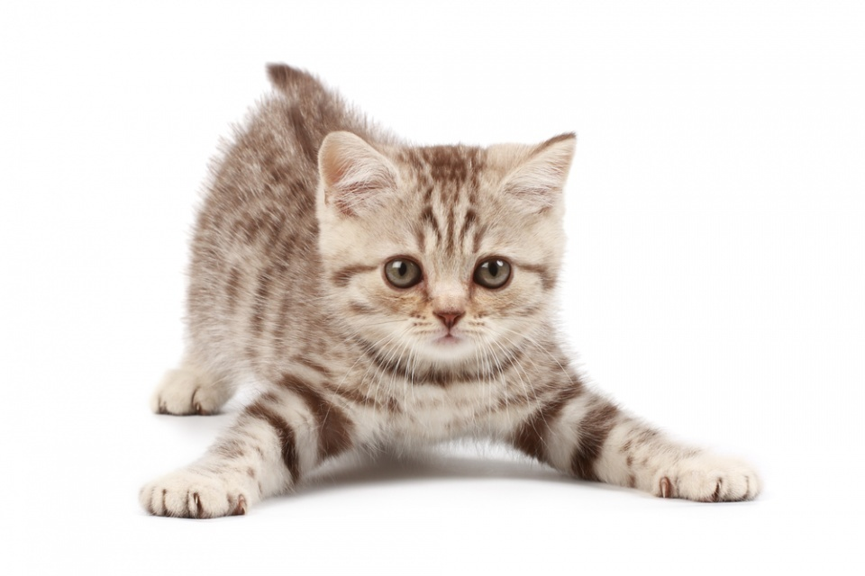
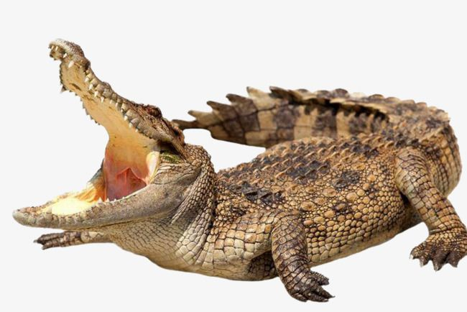
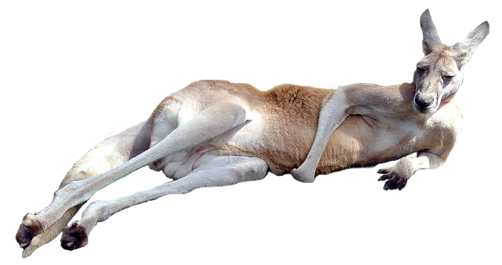
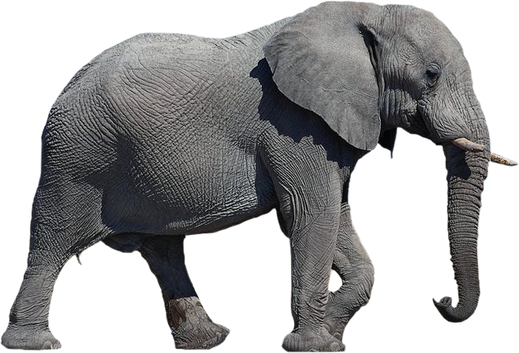
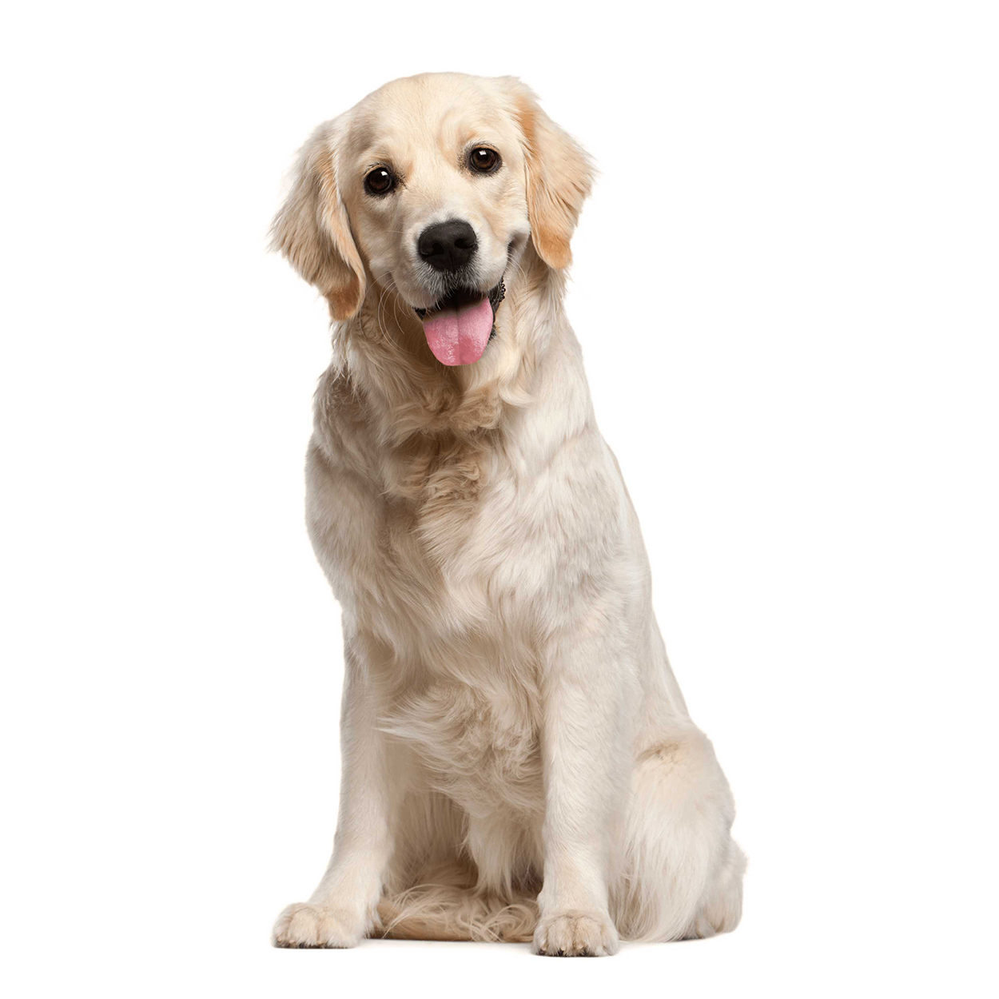
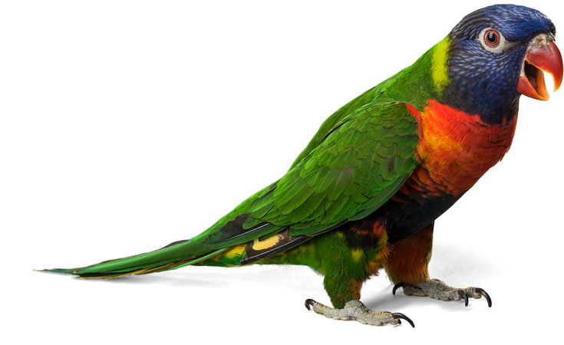
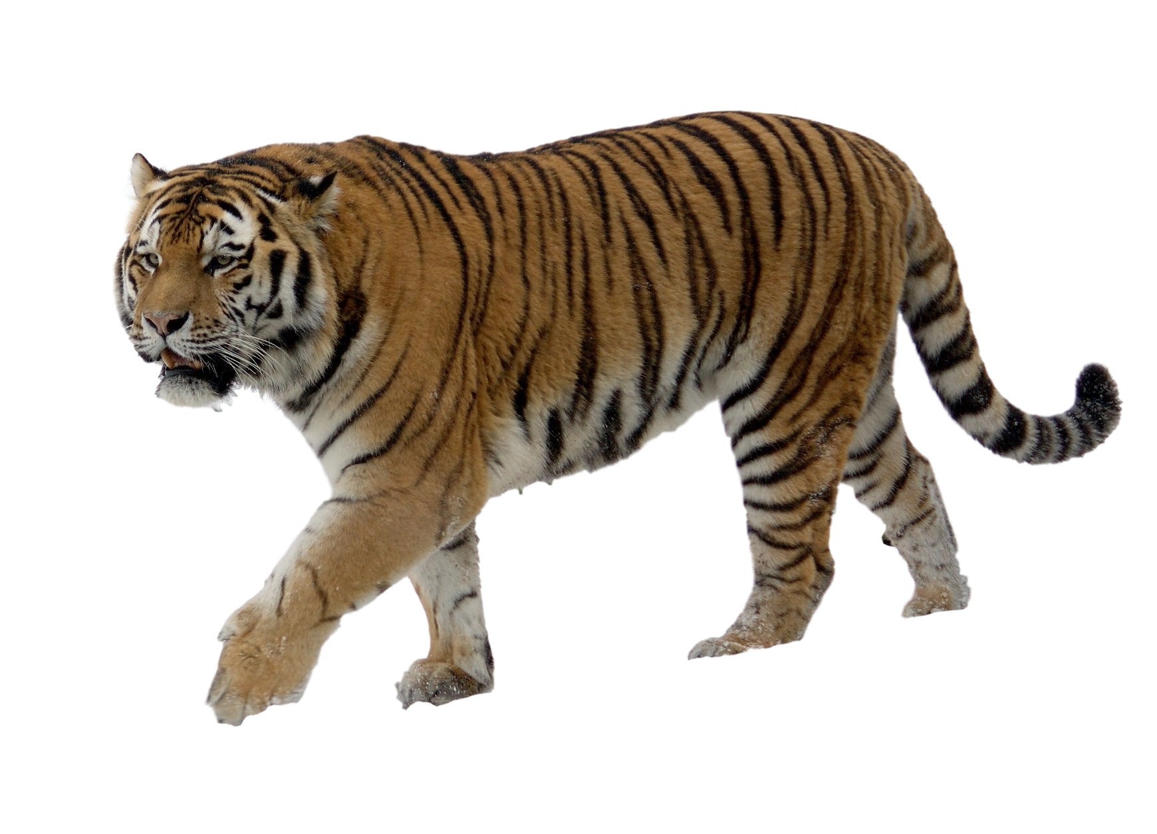
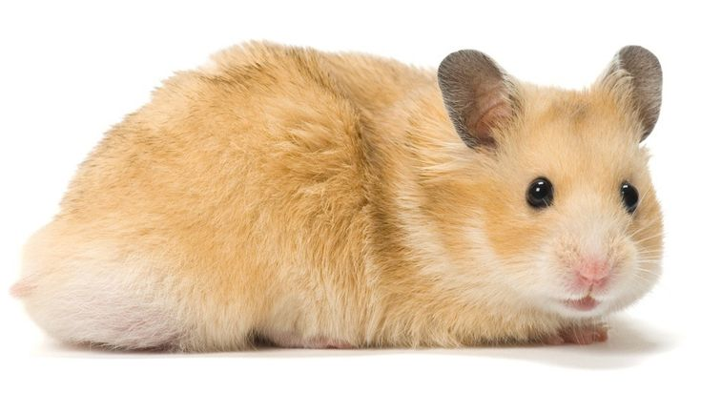
What is your favorite animal?
My …

Slide 6

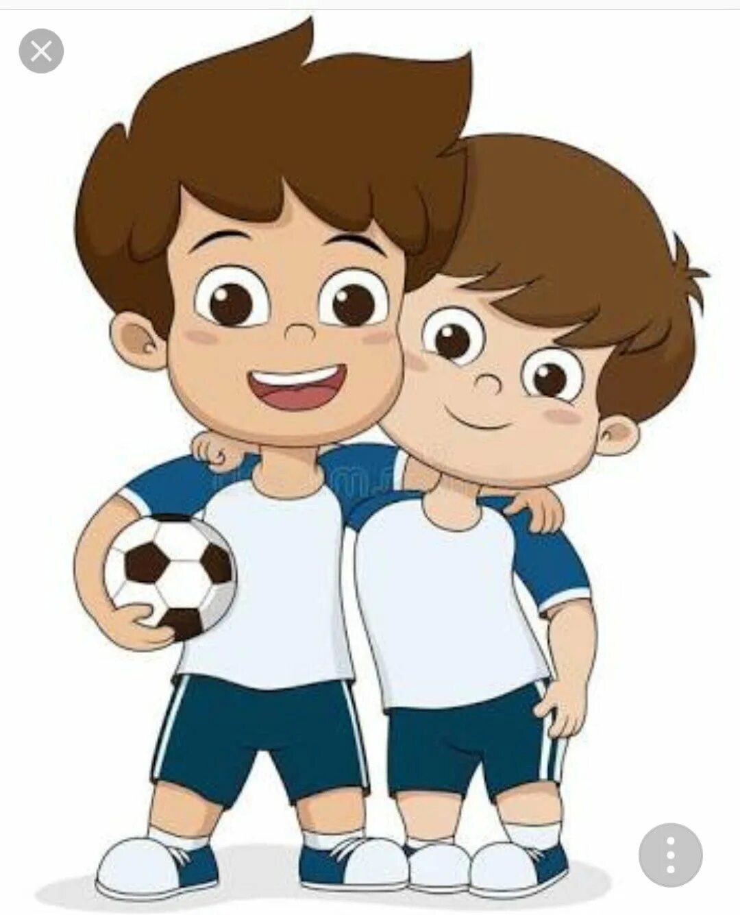
Reading with Julia
Two peas in a pod

Slide 7

Reading with Julia
Ben and Jack are the best friends. They are like two peas in a pod. They are always together. They go to school, play football, swim in a river, swing, climb trees, ride bikes, jump the ropes and slide down a slide. They are like brothers.

Slide 8
Reading with Julia
One day they went to the sea with their
parents. The weather was good and the boys were
happy. They run, built a sandcastle and
swam a lot.
Went – go
Was, were - be

Slide 9
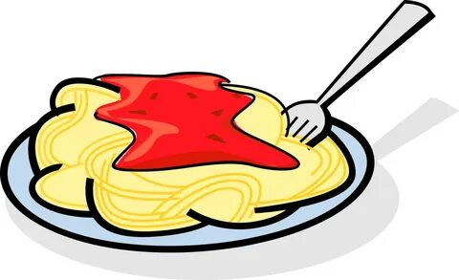
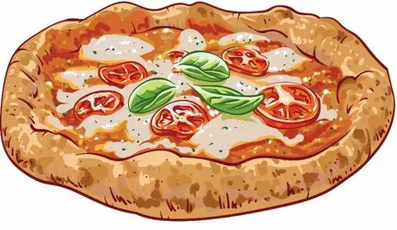
Reading with Julia
One day the families went to the restaurant to have dinner.
Ben’s favourite food was pizza, and Jack’s favourite food
was pasta.

Slide 10
Reading with Julia
Ben said: “I want some pizza. Let’s order it!”
Jack said: “I don’t really like pizza. Let’s order some pasta!”
Ben said: “It’s not tasty. Pizza is my favorite”
Jack said: “I don’t want to eat pizza.”
The boys were angry. Ben wanted to eat pizza and Jack
wanted to eat pasta.

Slide 11
Reading with Julia
The boys were quit. Ben’s mum said: “What do you want for a dinner?”
Ben said: “I want pizza, but Jack wants pasta”
Mum said: “Let’s order and pizza and pasta”
The boys were happy and glad.

